Slide 1
PID Controller

Slide 2
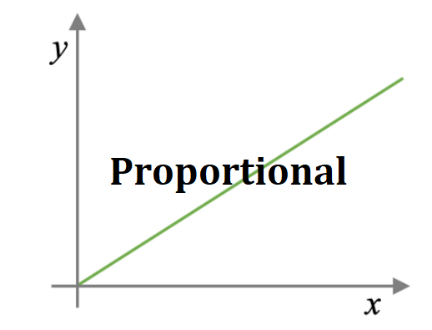
PID Controller
P = Proportional (Proportional means value of X –increases than Y-
axis also increases
I = Integral (Values are Increased)
D = Derivative (Values are Decreased)

Slide 3
Function Of Controller
Controller is used control the Steady State Error or Transient Response of the System.

Slide 4
Types Of Controllers
Proportional (P)
Controller
Integral (I) Controller
Derivative (D) Controller
Proportional-Integral Controller
Proportional-Derivative Controller
Proportional-Integral-Derivative Controller

Slide 5
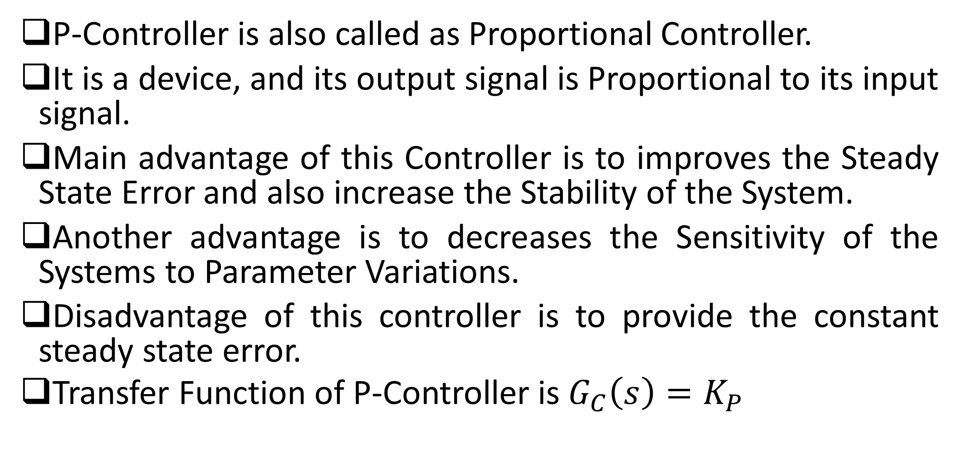
P-Controller (Proportional Controllers)
P-Controller is also called as Proportional Controller.
It is a device, and its output signal is Proportional to its input signal.
Main advantage of this Controller is to improves the Steady State Error and also increase the Stability of the System.
Another advantage is to decreases the Sensitivity of the Systems to Parameter Variations.
Disadvantage of this controller is to provide the constant steady state error.
Transfer Function of P-Controller is $G_{C}\left(s\right)=K_{P}$

Slide 6

P-Controller (Proportional Controllers)
Error Signal = Difference between output (feedback) and Input R(s) is the Error Signal Give to Controller
Output Signal is coming out from the Controller. OR also called as Manipulated Signal OR also called as Controlled Signal
Controller
Plant
R(s)
Input
C(s)
Output
-
$$E\left(s\right)=R\left(s\right)−C(s)$$
Feedback
Our main goal is to minimize the error using Proportional Controller

Slide 7

P-Controller (Proportional Controllers)
Controller
Plant
R(s)
Input
C(s)
Output
-
$$E\left(s\right)=R\left(s\right)−C(s)$$
Controller Input
OR
Error signal E(t)
Controller Output
OR
Manipulated Output M(t)
K_{P}
Proportional Controller has constant Gain (K_{P})

Slide 8

P-Controller (Proportional Controllers)
K_{P}
E(t)
M(t)
Output of Proportional Controller M(t) is the Input E(t) * Constant Gain K_{P}
$$M\left(t\right)= K_{P}E(t)$$

Slide 9
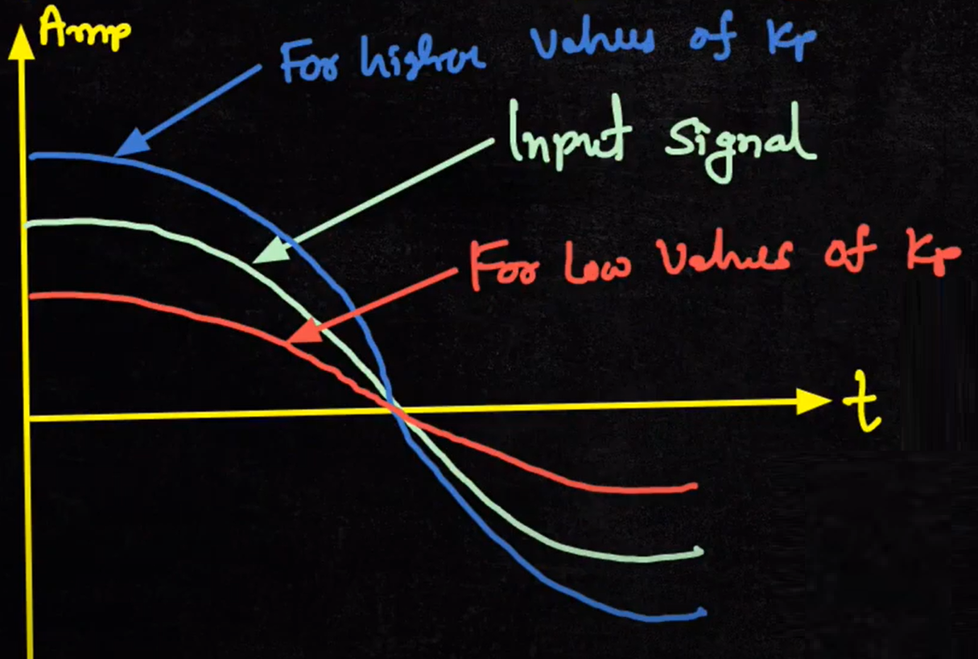

Slide 10
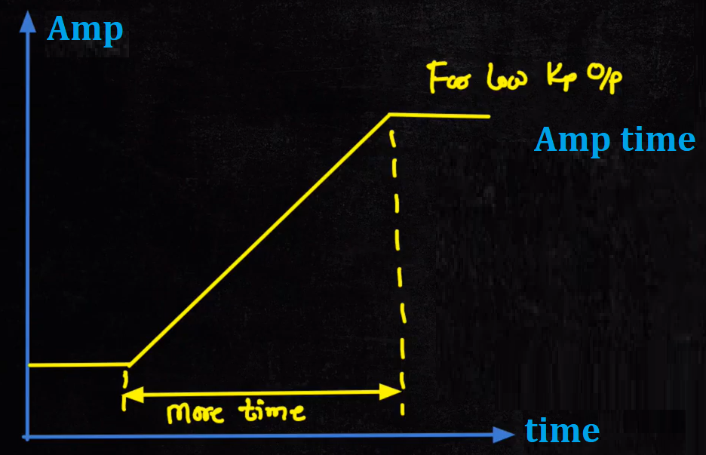
Significance of Proportional Controller
How output is reacting to the input, we consider two cases:
First Case: We choose lower value of K_{P} , then our output response will be slower in terms of changing in output or taking more time from one level of Amplitude to another level of Amplitude.

Slide 11
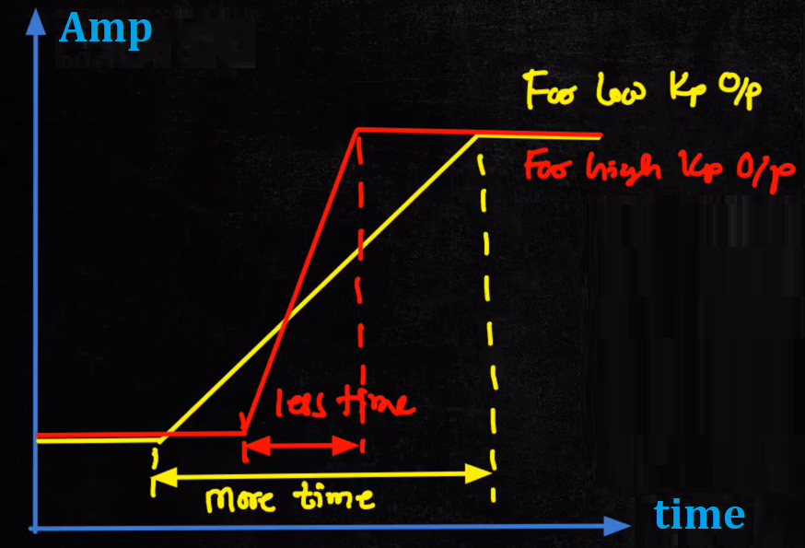
Significance of Proportional Controller
Second Case: We choose higher value of K_{P} , then our output response will be rising faster in terms of changing in output or taking less time from one level to another level of Amplitude.

Slide 12
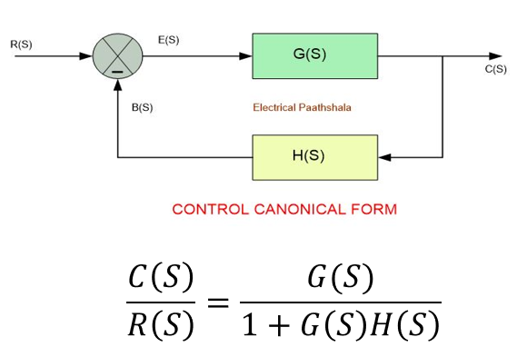
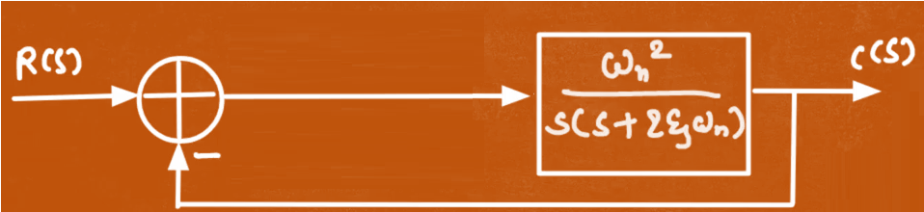
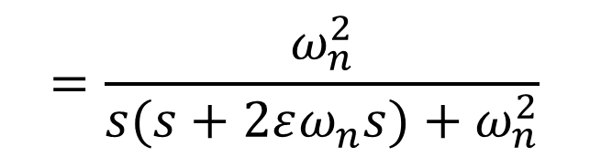
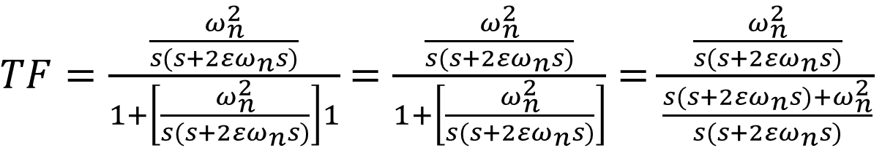
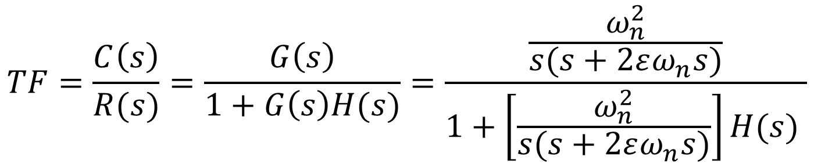
Calculate the Second Order Transfer Function of Closed Loop System
G(s)
$$TF=\frac{C\left(s\right)}{R(s)}=\frac{G\left(s\right)}{1+G\left(s\right)H(s)}=\frac{\frac{ω_{n}^{2}}{s(s+2εω_{n}s)}}{1+\left[\frac{ω_{n}^{2}}{s(s+2εω_{n}s)}\right]H(s) }$$
$TF=\frac{\frac{ω_{n}^{2}}{s(s+2εω_{n}s)}}{1+\left[\frac{ω_{n}^{2}}{s(s+2εω_{n}s)}\right]1}$ $=\frac{\frac{ω_{n}^{2}}{s(s+2εω_{n}s)}}{1+\left[\frac{ω_{n}^{2}}{s(s+2εω_{n}s)}\right]}$ $=\frac{\frac{ω_{n}^{2}}{s(s+2εω_{n}s)}}{\frac{s(s+2εω_{n}s)+ω_{n}^{2}}{s(s+2εω_{n}s)}}$
$$=\frac{ω_{n}^{2}}{s(s+2εω_{n}s)+ω_{n}^{2}}$$

Slide 13
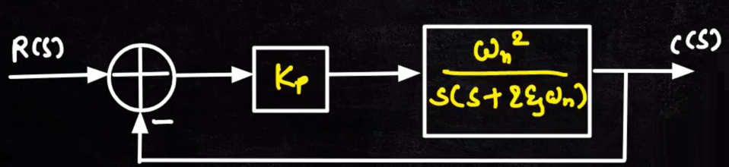
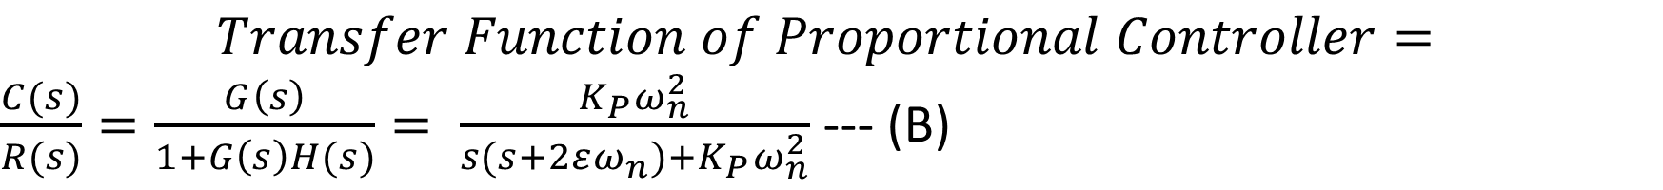
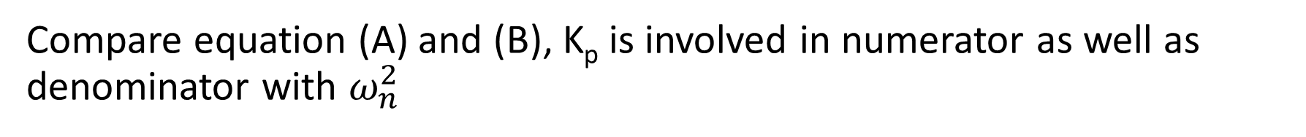
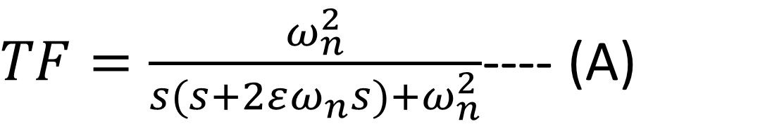
Second-Order Transfer Function of Proportional Controller
G(s)
K_{P} in series with G(s) then multiply K_{P} with G(s)
$TF=\frac{ω_{n}^{2}}{s(s+2εω_{n}s)+ω_{n}^{2}}$---- (A)
$$Transfer Function of Proportional Controller=$$
$\frac{C(s)}{R(s)}=\frac{G\left(s\right)}{1+G\left(s\right)H(s)}= \frac{K_{P}ω_{n}^{2}}{s(s+2εω_{n})+K_{P}ω_{n}^{2}}$ --- (B)
Compare equation (A) and (B), K_{p} is involved in numerator as well as denominator with $ω_{n}^{2}$

Slide 14
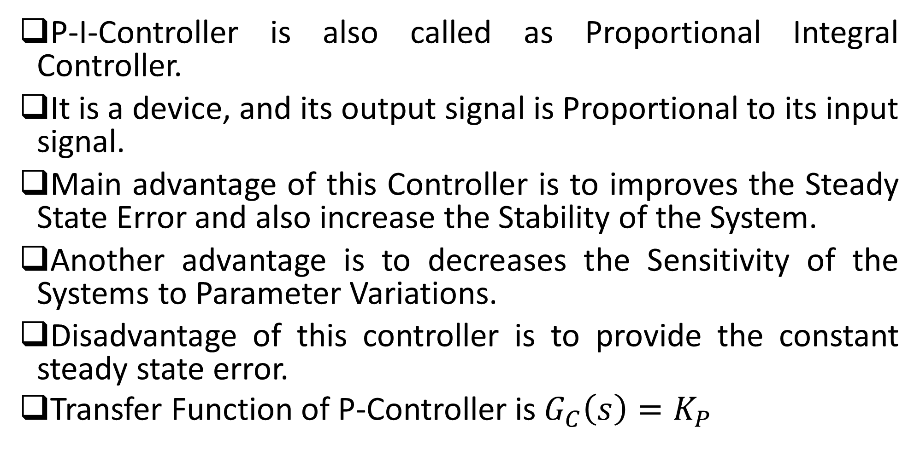
P-I-Controller
P-I-Controller is also called as Proportional Integral Controller.
It is a device, and its output signal is Proportional to its input signal.
Main advantage of this Controller is to improves the Steady State Error and also increase the Stability of the System.
Another advantage is to decreases the Sensitivity of the Systems to Parameter Variations.
Disadvantage of this controller is to provide the constant steady state error.
Transfer Function of P-Controller is $G_{C}\left(s\right)=K_{P}$

